Slide 1

ESP 106
Lecture 3

Slide 2


Repetition

Slide 3

loops
for loop
Repeat instructions for n cases
while loop
Repeat instructions until done

Slide 4

for loops
x <- 11:15
n <- length(x)
y <- 0
for (i in 1:n) {
y <- y + x[i]
}
y
#[1] 65

Slide 5
for loops
x <- 11:15
n <- length(x)
y <- 0
# 1) "for", "variable", "sequence"
for (i in 1:n)
# 2) begin loop (scope)
{
# 3 loop body
y <- y + x[i]
# 4) end loop
}
y
#[1] 65

Slide 6
for loops
s <- c("hannah", "ying", "julia")
for (i in 1:length(s)) {
s[i] <- paste(s[i], "is a student")
}
s
#[1] "hannah is a student" "ying is a student" "julia is a student"

Slide 7
for loops
x <- 11:15
n <- length(x)
y <- 0
z <- 0
for (i in 1:n) {
y <- y + x[i]
z <- z + i
print(y)
}
y
#[1] 65
z
#[1] 15

Slide 8
for loops
s <- c("hannah", "ying", "julia")
for (name in s) {
print(paste(name, "is a student"))
}
[1] "hannah is a student"
[1] "ying is a student"
[1] "julia is a student"

Slide 9
for loops
this works
x <- 11:15
y <- 0
for (i in 1:length(x)) {
y <- y + x[i]
}
sum(x)
#[1] 65
but this is much better

Slide 10
for loops
this works
x <- 11:15
for (i in 1:length(x)) {
x[i] <- x[i] * 2
}
x * 2
#[1] 22 24 26 28 30
but this is much better

Slide 11
while loops
x <- 100
n <- 0
while (x > 0.001) {
x <- x / 2
n <- n + 1
}
x
#[1] 0.000762
n
#[1] 17

Slide 12
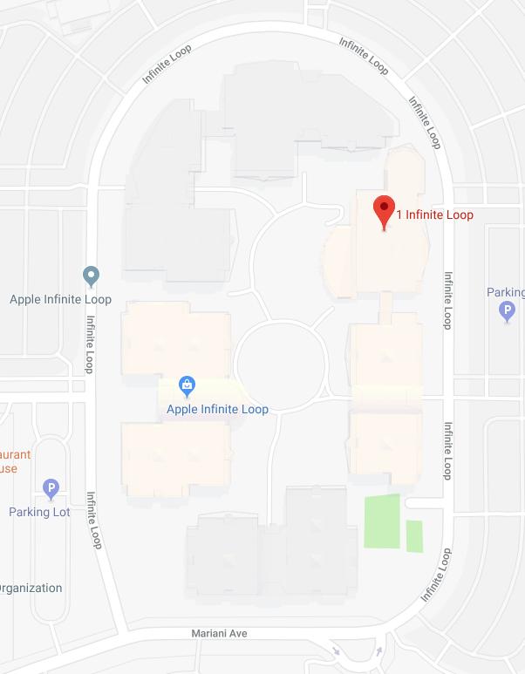

Slide 13
while loops
x <- 1000
n <- 0
while (x > 0.001) {
x <- x / 2
n <- n + 1
if (n > 15) break
}
x
#[1] 0.0153
n
#[1] 16

Slide 14

conditional action

Slide 15
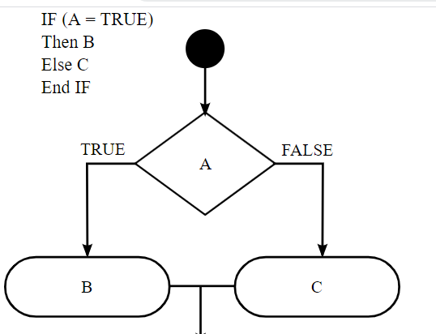
conditional statements

Slide 16
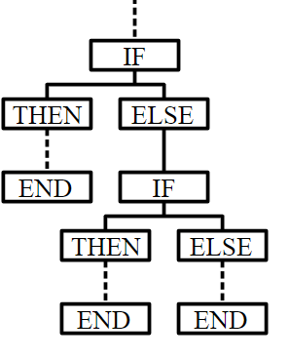
conditional statements

Slide 17
if – then
x <- 10
s <- "unknown"
if (x < 5) {
s <- "small number"
}
s
#[1] "unknown"
s <- "unknown"
if (x > 5) {
s <- "big number"
}
s
#[1] "big number"

Slide 18
if – then – else
x <- 10
if (x > 5) {
s <- "big number"
} else {
s <- "small number"
}
s
#[1] "big number"

Slide 19
if – then – else
x <- 4:6
for (y in x) {
if (y > 5) {
print("big number")
} else {
print("small number")
}
}
#[1] "small number"
#[1] "small number"
#[1] "big number"

Slide 20
if – then – else if – else
x <- 1:10
y <- rep(NA, 10)
for (i in 1:length(x)) {
if (x[i] < 4) {
y[i] <- 0
} else if (x[i] < 8) {
y[i] <- 1
} else {
y[i] <- 2
}
}
y
# [1] 0 0 0 1 1 1 1 2 2 2

Slide 21
ifelse and replacement
ifelse
x <- 1:10
y <- ifelse(x < 4, 0, ifelse(x < 8, 1, 2))
y
# [1] 0 0 0 1 1 1 1 2 2 2
y <- x * 0
y[(x > 3) & (x < 8)] <- 1
y[x > 7] <- 2
# [1] 0 0 0 1 1 1 1 2 2 2
replacement

Slide 22
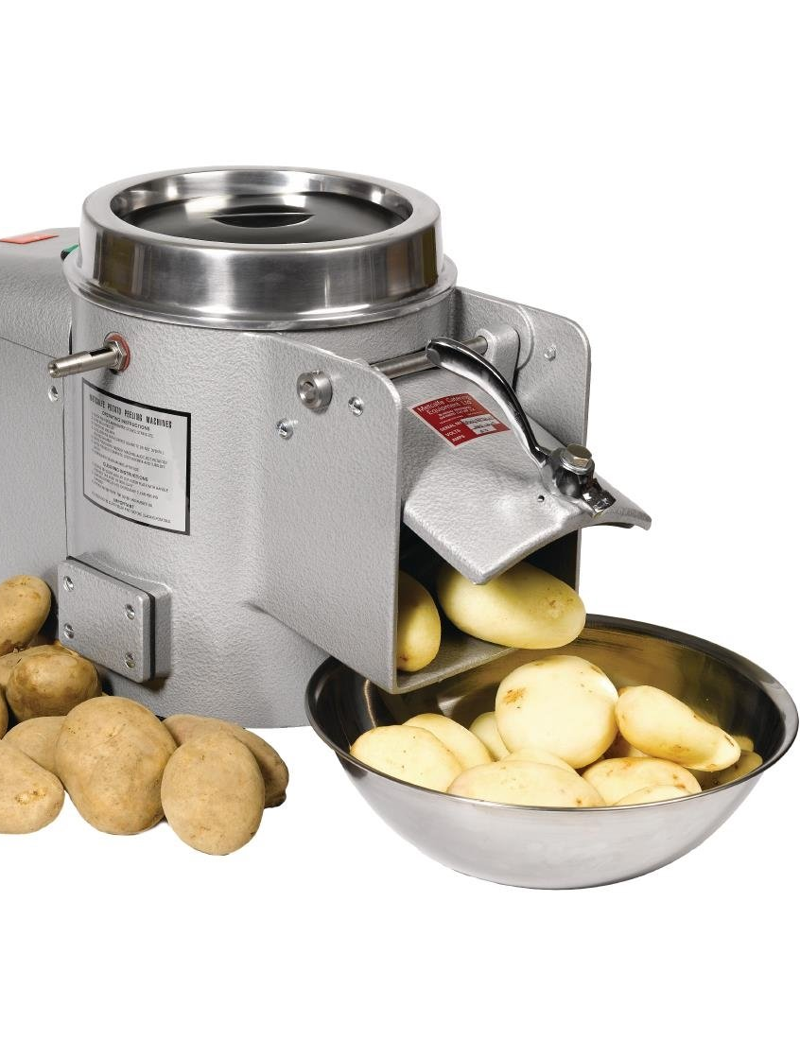
functions

Slide 23
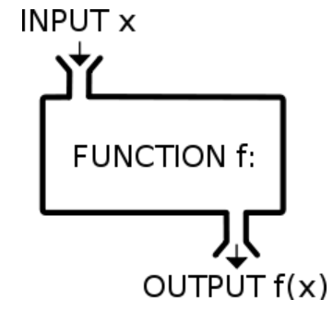

Slide 24
functions
y = f (x)
x <- 25
y <- sqrt(x)
#[1] 5

Slide 25
functions
f <- function() {
print("hello!")
}
f()
#[1] "hello!"
f()
#[1] "hello!"
f
#function() {
# print("hello!")
#}

Slide 26
functions
# 1) name, function, (arguments)
f <- function()
# 2) begin function (scope)
{
# 3) function body
print("I like you!")
# 4) end function
}

Slide 27
functions
sumlog <- function(a, b) {
x <- log(a) + log(b)
return(x)
}
sumlog(1, 2)
#[1] 0.6931472
sumlog(1:5, 2)
#[1] 0.693 1.386 1.792 2.079 2.303

Slide 28
functions
sumlog <- function(a, b) {
x <- log(a) + log(b)
return(x)
}
sumit <- function(a, b) {
log(a) + log(b)
}

Slide 29
apply a function
x <- cbind(a=1:5, b=5:1, c=1:5)
x
a b c
[1,] 1 5 1
[2,] 2 4 2
[3,] 3 3 3
[4,] 4 2 4
[5,] 5 1 5
apply(x, 1, sum)
[1] 7 8 9 10 11
apply(x, 2, sum)
a b c
15 15 15
>

Slide 30
Apply more
tapply (aggregate)
lapply, sapply
x <- list(1:10)
lapply(x, function(x) x + 5)
[[1]]
[1] 6 7 8 9 10 11 12 13 14 15

